Slide 1

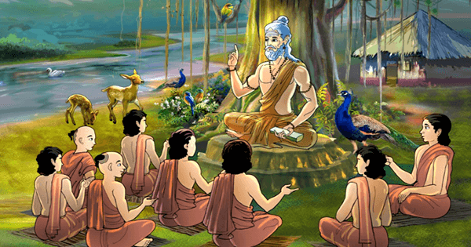
Gurukul Learning:
Ancient Method meeting Modern Day
Team Id: H26EDU03
Team Lead: Nagella Venkata Siva Sai Advik
Team Members: Barath Kumar S
Collage Name: Kumaraguru Collage of Technology

Slide 2



Problem Definition & Its Significance
Historically, high-quality, 1-on-1 tutoring is an exclusive privilege.
Mass education systems face impossible student-to-teacher ratios.
Result: Millions fall behind in foundational logic, literacy, and numeracy.
Objective:
Democratize elite-level, personalized mentorship at consumer scale.
Approach:
Build a multi-agent AI tutor that dynamically adapts its teaching metaphor, regional dialect, and difficulty based on the learner's age and passions.

Slide 3


Literature Survey & The Gap
Existing EdTech AI acts like a rigid encyclopedia. It hallucinates and lacks emotional intelligence.
Great teachers use regional dialects, local culture, and students' personal interests to make learning more relatable and effective.
Current AI fails to replicate this human connection.
Current Gap:
Adaptive Persona & Tone: Missing in current solutions.
Regional Dialect/Idioms: Missing in current solutions
Non-linear Fallback Routing: Missing (Standard AI just repeats "Try Again").

Slide 4
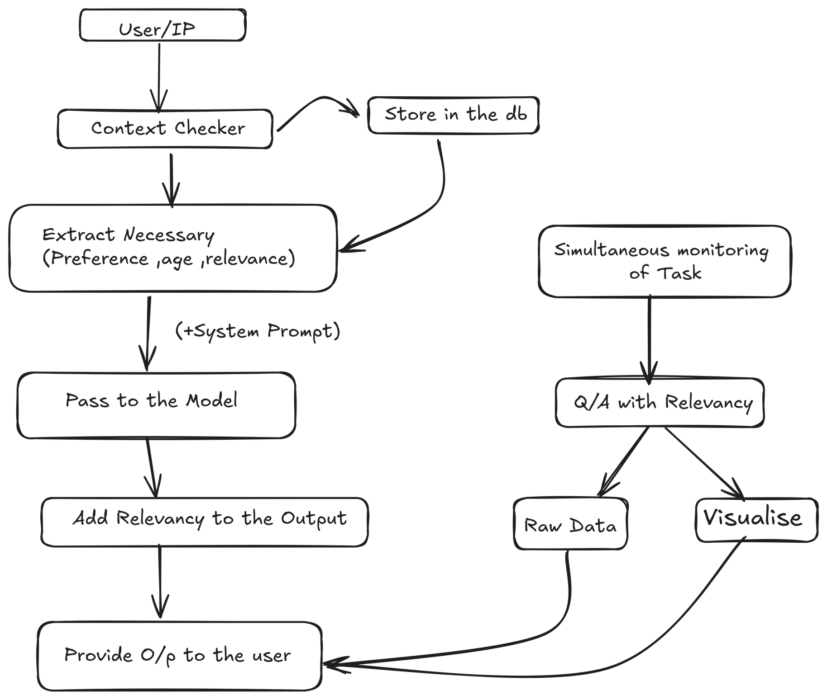
Flow

Slide 5








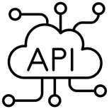

NVIDIA API
System Architecture
Personalized Audio/Presentation
(Add-On)
Multi - Agent Orchestrator
Phase A : Learner Profiling (Context Taker)
Phase B: Personalized Learning Engine (Learning Loop)
Backend Server (State and Routing Managet)
Relevancy and Rule Evaluvator
Learner UI(Web/Mobile Interface)
Agent for Voice
(Add-On)
Database
Phase A
GET /api/onboard
POST /api/onboard/submit
Phase B
POST /api/learn/start
POST /api/learn/generate
GET /api/learn/stream
PATCH /api/learn/evaluate
Knowledge Tester
(Add-On)

Slide 6
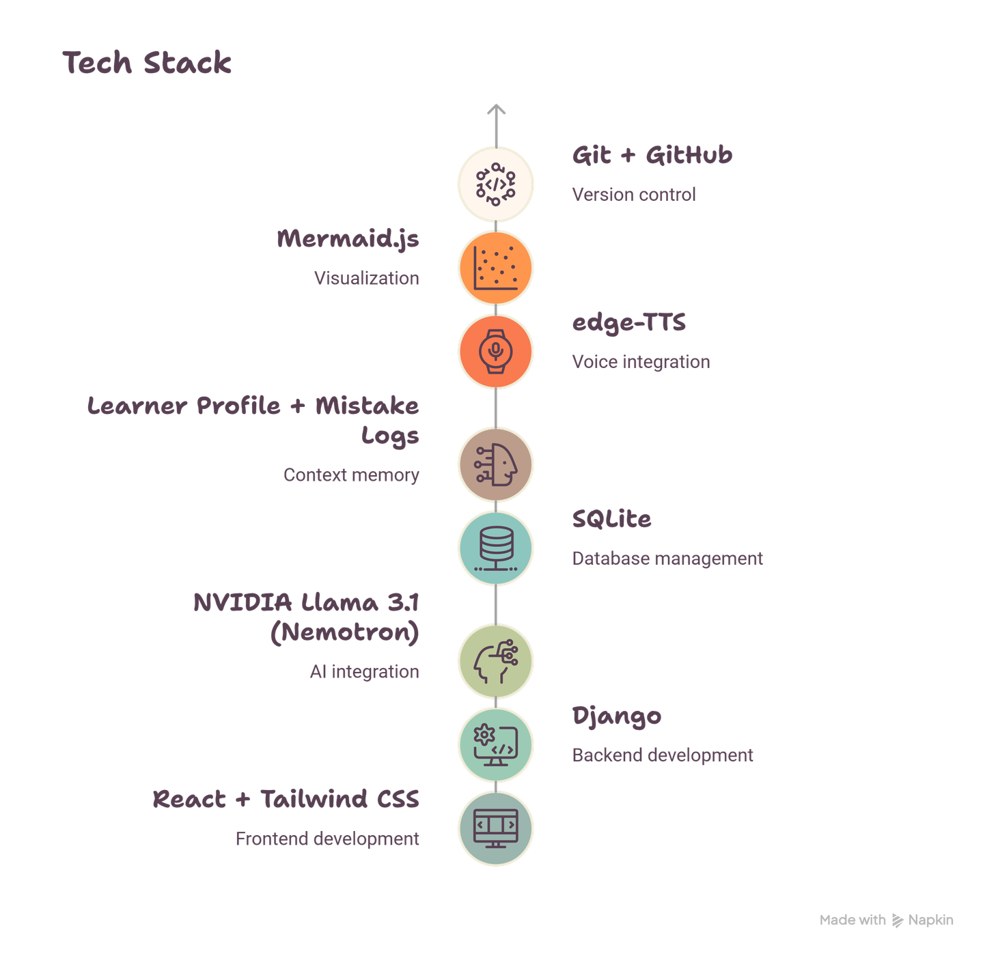

Slide 7
Result and Demo Video

Slide 8
Exisiting Solution and Novelty
Existing Solutions
Generic AI responses
Fixed learning paths for all users
Little or no long-term learner memory
Limited personalization
Focus on answering questions rather than improving learning
Gurukul AI
Dynamic learner persona
Personalized learning tracks
Multi-agent AI (NVIDIA + Gemini)
Context & progress memory
Regional & visual learning
Adaptive teaching strategy

Slide 9
Summary with future work(Productisation)
OCR for handwritten notes
PDF & document learning
Image understanding
Emotional regional TTS
Parent & teacher dashboards
Learning analytics
Multi-device synchronization
Offline mode
LMS integration

Slide 10


Slide 11

Current Development & Preliminary Results
Frontend:Still need to start on building
Backend: Django server with LearnerProfile and MistakeLog models.
Multi-Agent AI: NVIDIA Llama 3.1 + Gemini APIs integrated and working together.
Adaptive Learning: AI personalizes lessons.
Current Status: Core AI pipeline is fully functional; integrating with Django frontend.

Slide 12
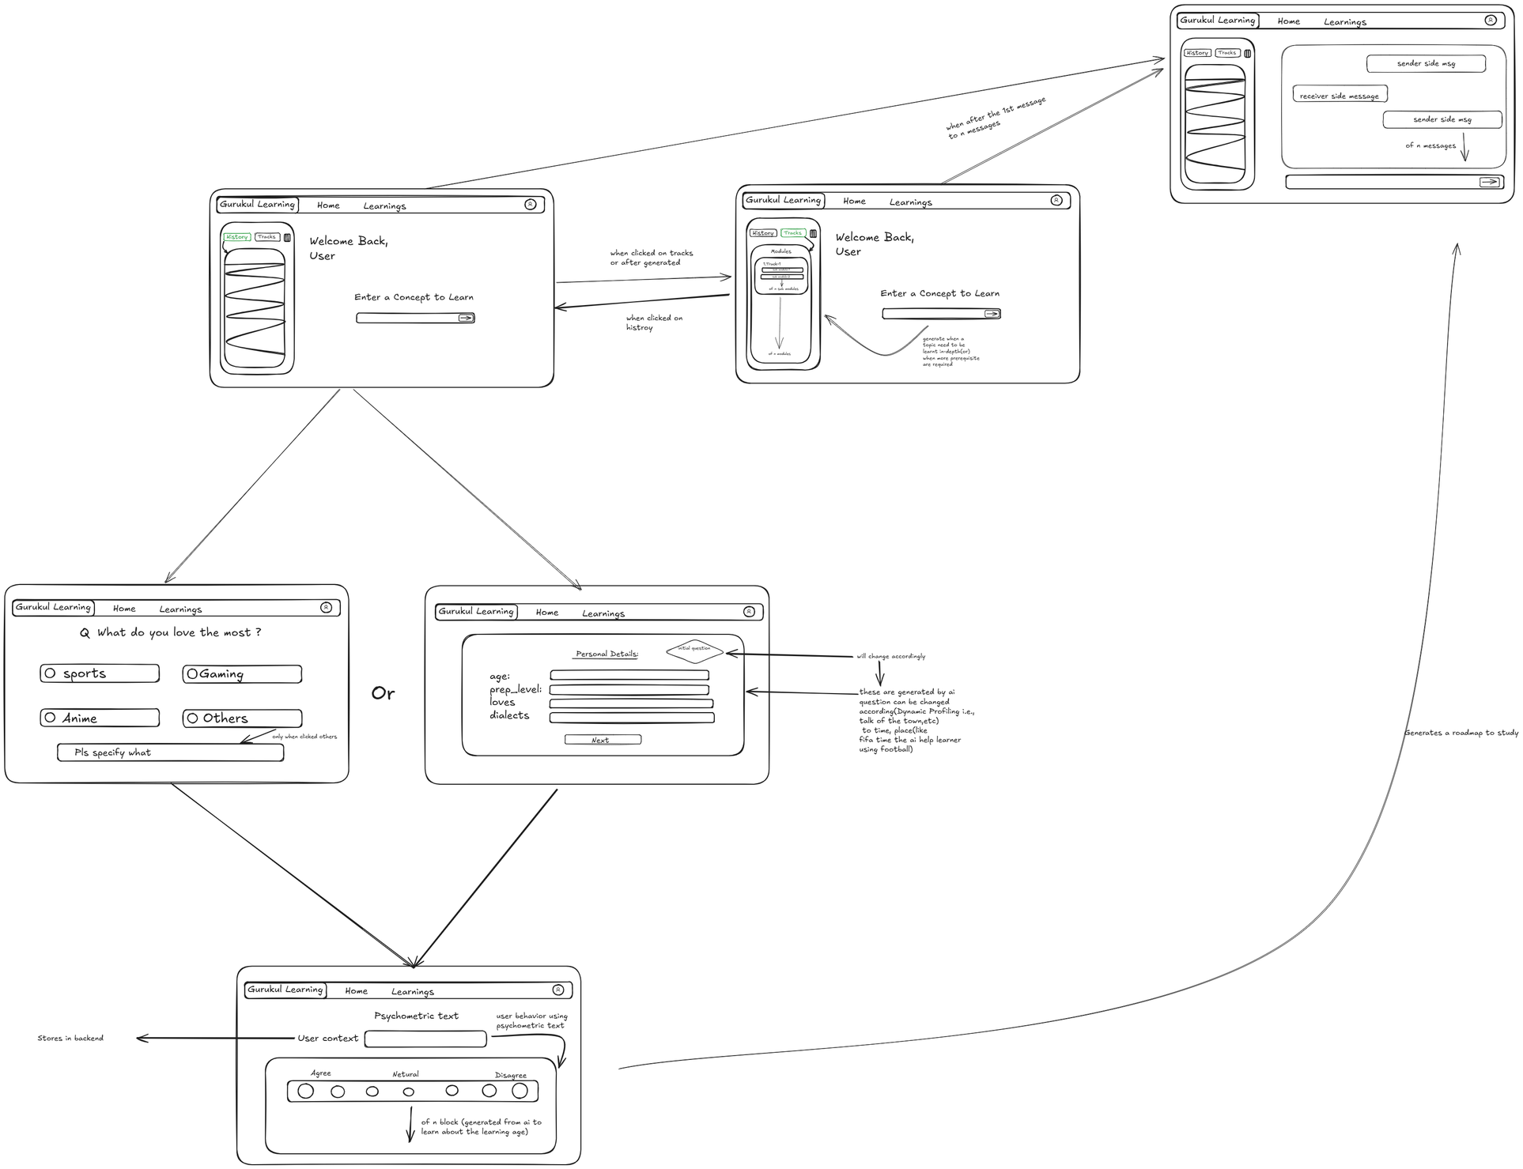
Initial Wireframe Design

Slide 13
Target Beneficiaries
Individual farmers
Farmer Producer Organizations (FPOs)
Rural microfinance institutions
Agricultural cooperatives and banks
Significance
Over 65% of Indian farmers lack access to formal credit.
Unpredictable weather and lack of risk evaluation tools worsen financial instability.
Empowering farmers with fair credit scores ensures financial inclusion and climate resilience.

Slide 14
Value Proposition & Its Impact
Impact
Gives banks data-driven confidence to lend to rural farmers.
Provides farmers with transparent and fair access to credit.
Key Benefits
Improved credit access for unbanked farmers.
Disaster-aware scoring minimizes financial losses for both banks and farmers.
Secure and scalable system using AI and encryption.
Climate resilience through early disaster prediction.
Uniqueness
Introduces a “Disaster Prediction Parameter”, not found in existing credit scoring models.
Uses alternate, non-traditional data — such as weather, tech usage, and crop patterns — to ensure fairness.

Slide 15
Market Opportunity & TAM size
Market Opportunity
India has ~140 million farmers, of which only ~30% have formal credit access.
Agri-fintech market in India projected to reach USD 24 billion by 2030.
Adjacent Opportunities
Crop insurance risk modeling
Microloan management for rural businesses
Government welfare and subsidy verification systems

Slide 16
Team & Partnership
Team Composition
AI/ML Developer: Builds and trains predictive credit models.
Data Analyst: Handles alternate data preprocessing and integration.
Agriculture Expert: Validates farm and environmental parameters.
Frontend Developer: Builds user-friendly web dashboard.
Cybersecurity Lead: Manages encryption and data privacy.
Potential Partnerships
NABARD, SBI, and other rural banks.
IMD (Indian Meteorological Department) for weather API data.
Agri-tech startups for farm and yield data.
Government schemes like PM-Kisan, PMFBY.

Slide 17
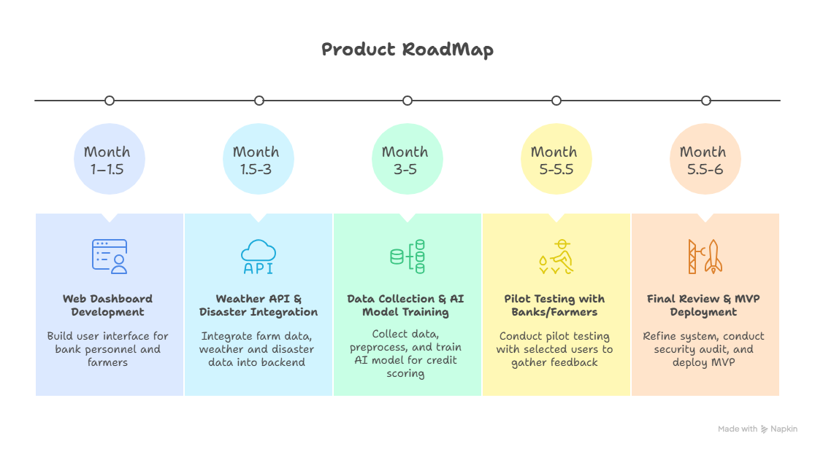

Slide 18
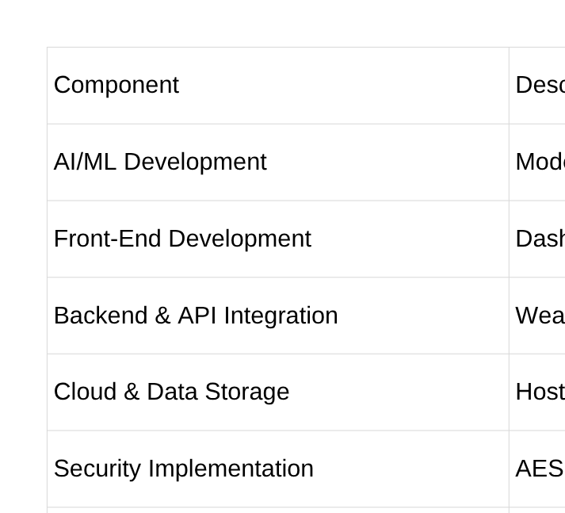
Budget

Slide 19
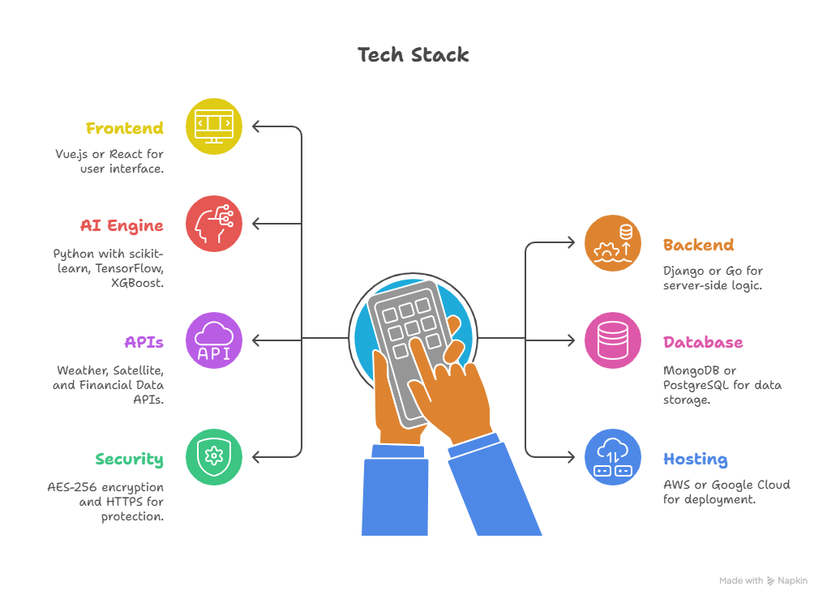

Slide 20
Research and References
“Machine Learning (ML) Technologies for Digital Credit Scoring in Rural Finance: A Literature Review” by Anil Kumar,Suneel Sharmaand and Mehregan Mahdavi(2021)
“Credit Scoring Model for Farmers using Random Forest” by Kharida Aulia Bahri,Yeni Herdiyeni,Suprehatin Suprehatin(2023).
“Transforming Credit Access: Built an AI-Driven Lending Ecosystem”(2025)
“Crop yield Data with Soil And Weather Dataset”
“Agriculture Data set in the Karnataka”
“Forecasting Disaster Management in 2024”

